Slide 1


Presented By-
Subodh Srivastava (201500710)
Raj Sinha (201500552)
Himanshu Kushwaha (201500296)
InsightBot
InsightBot, is a cutting-edge AI chatbot designed to provide fast and accurate support to users seeking information or assistance

Slide 2

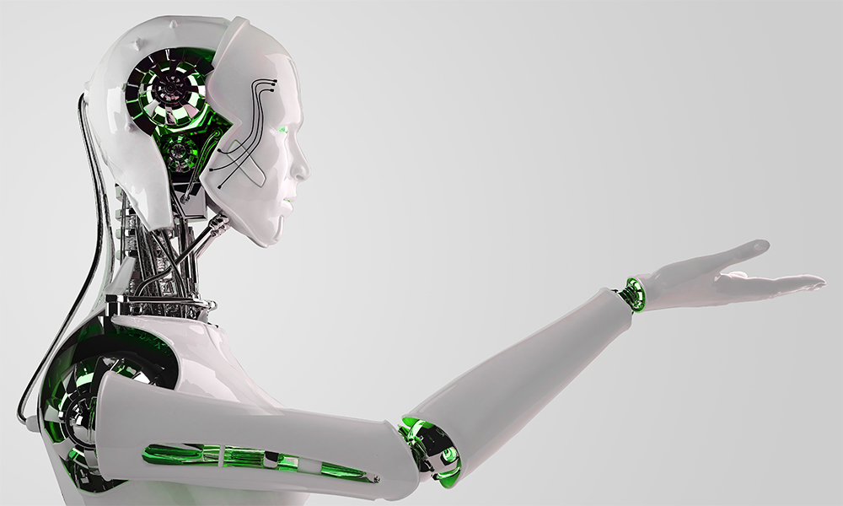

About
OpenAI
InsightBot
OpenAI is an artificial intelligence research laboratory consisting of the for-profit OpenAI LP and its parent company, the non-profit OpenAI Inc.

Slide 3
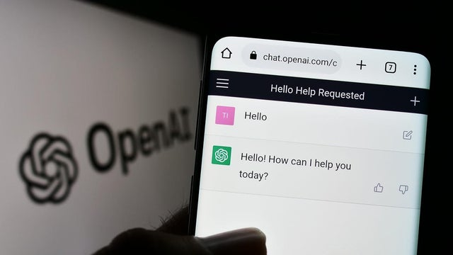
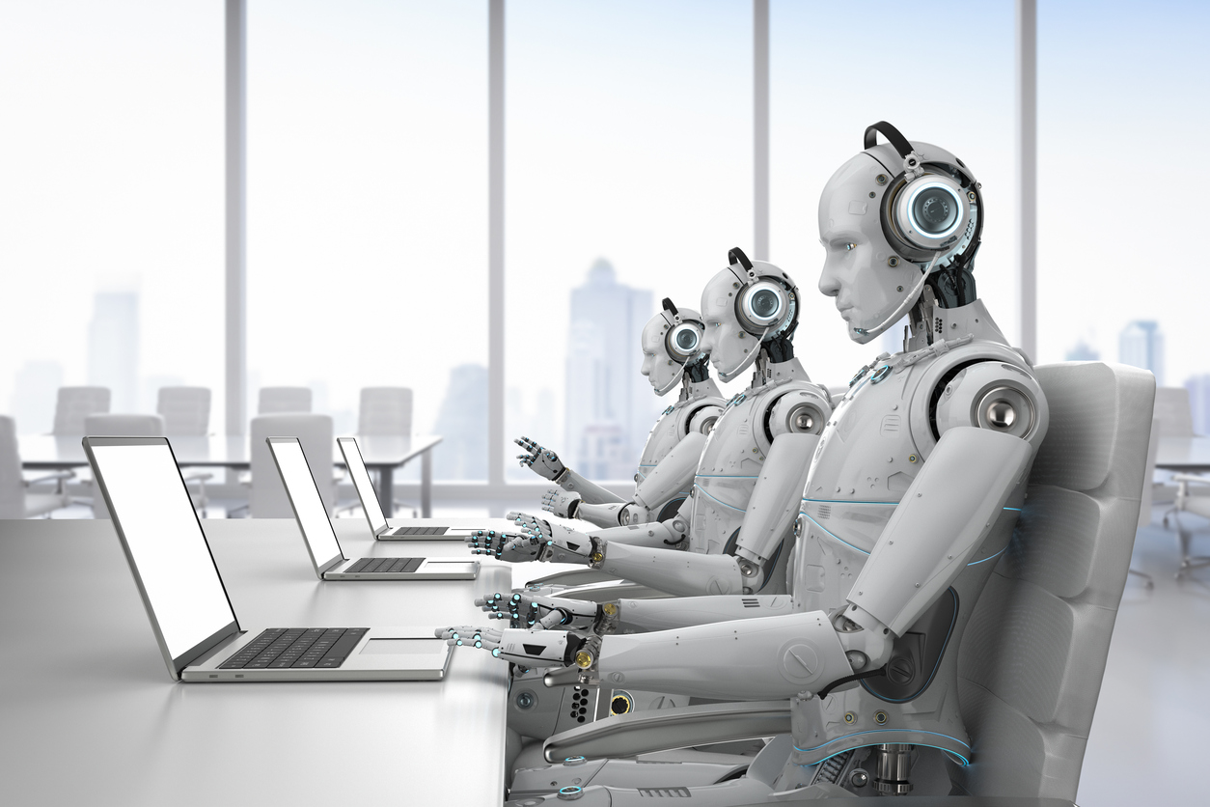
OpenAI’s Goals
The goals of OpenAI are to develop and promote friendly AI in a way that benefits all of humanity. They conduct research in a variety of areas related to AI, including machine learning, computer vision, natural language processing, and robotics.

Slide 4
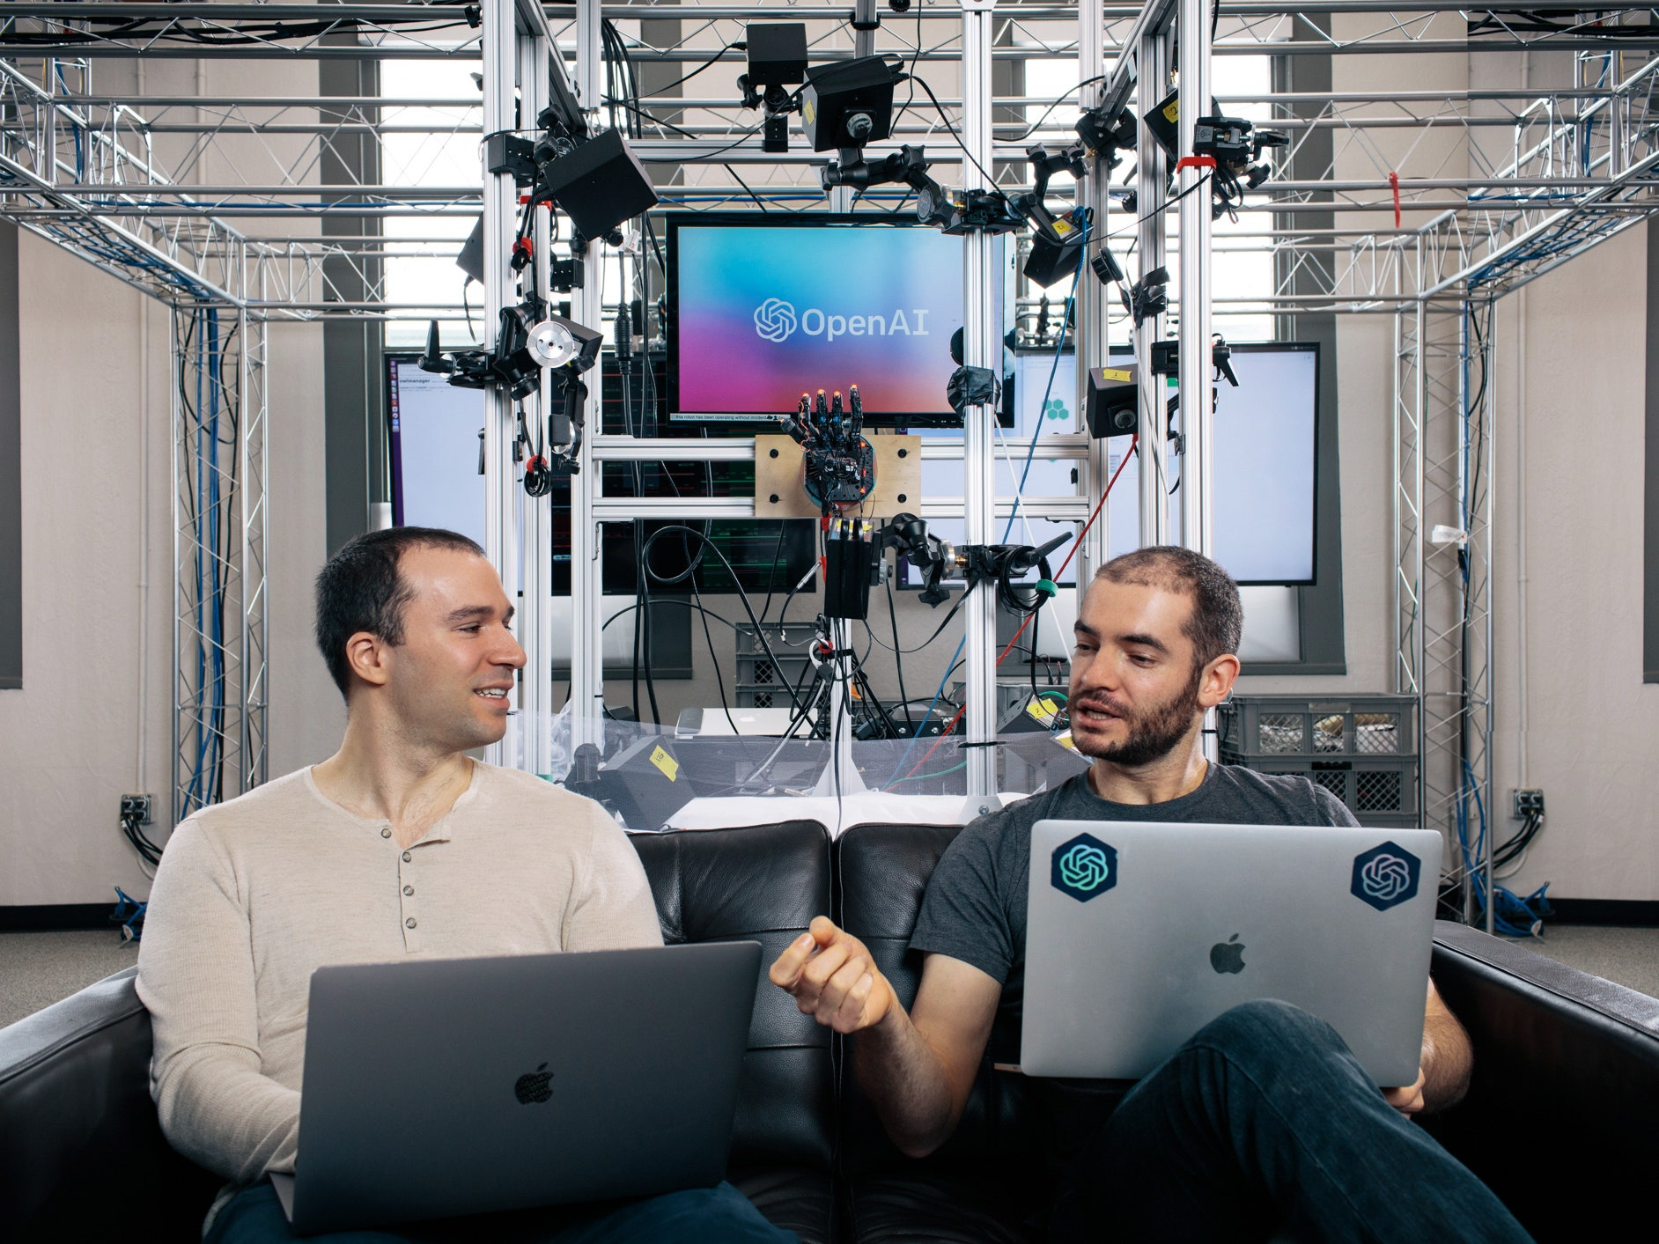

OpenAI’s
Mission
OpenAI's mission is to ensure that artificial general intelligence (AGI) benefits all of humanity. The company has a strong emphasis on transparency and open research, and they release many of their research papers and models under open-source licenses.
OpenAI also offers a cloud-based platform for developers and researchers to access and use their AI models and tools.

Slide 5

InsightBot
InsightBot is a large language model. It is based on the transformer architecture and is trained on a dataset of internet text to generate human-like responses to natural language prompts. It is capable of performing a wide range of language tasks such as question answering, text completion, and language translation. The model's performance can be fine-tuned for specific applications by training it on a task-specific dataset.

Slide 6

Language Generation
Question Answering
Text Completion
Language Translation
Summarization
InsightBotUsage

Slide 7

InsightBot Advantage
There are several advantages to using ChatGPT or other large language models like it:
1. High Quality of Generated Text
2. Cost
effective
3. Large
Vocabulary
4. Speed
5. Easy to use
6. Flexibility

Slide 8

Step 1: Create an account on the Insight Bot.
Step 2: Login using correct credentials
Step 3: Ask questions or give any query according to your need (you can take help of prompts)
Step 4: Press Enter and you will get a suitable solution for your query
How To Get InsightBot?

Slide 9
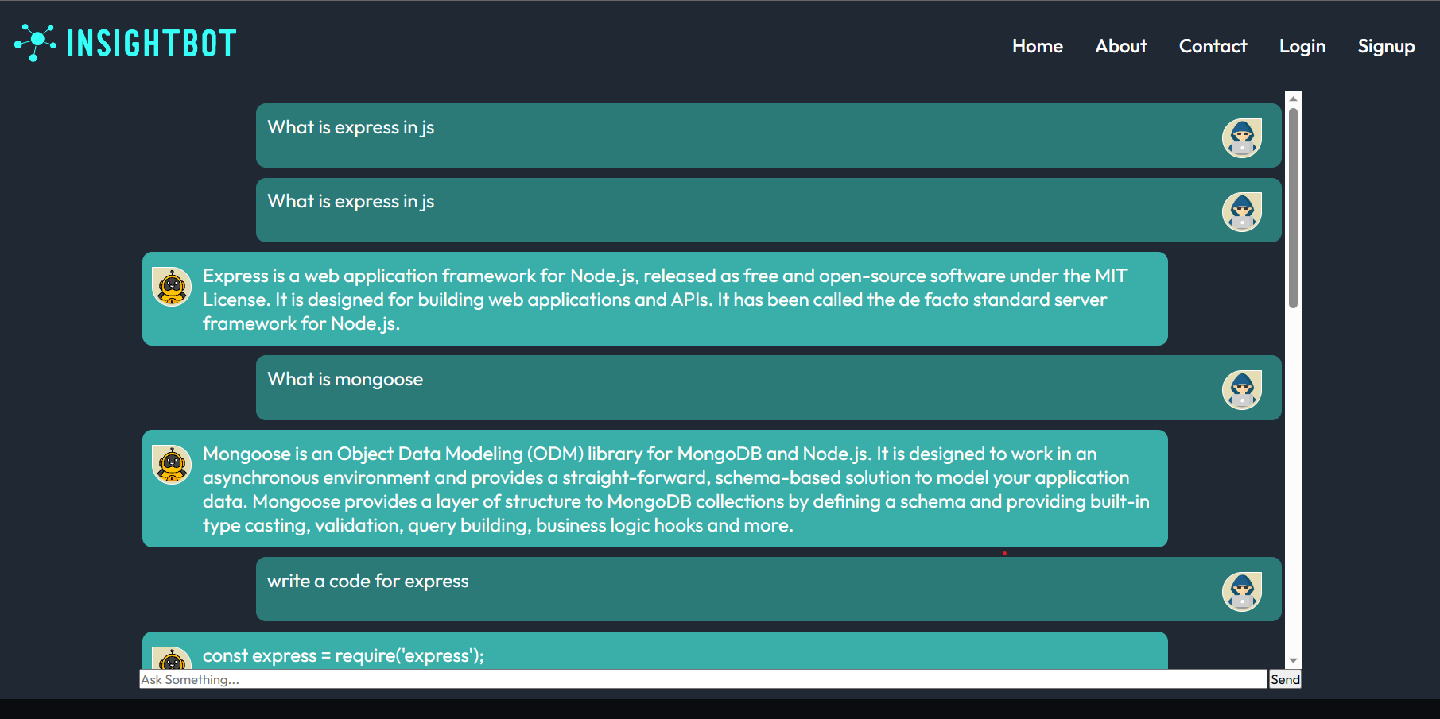
Natural Language Processing

Slide 10
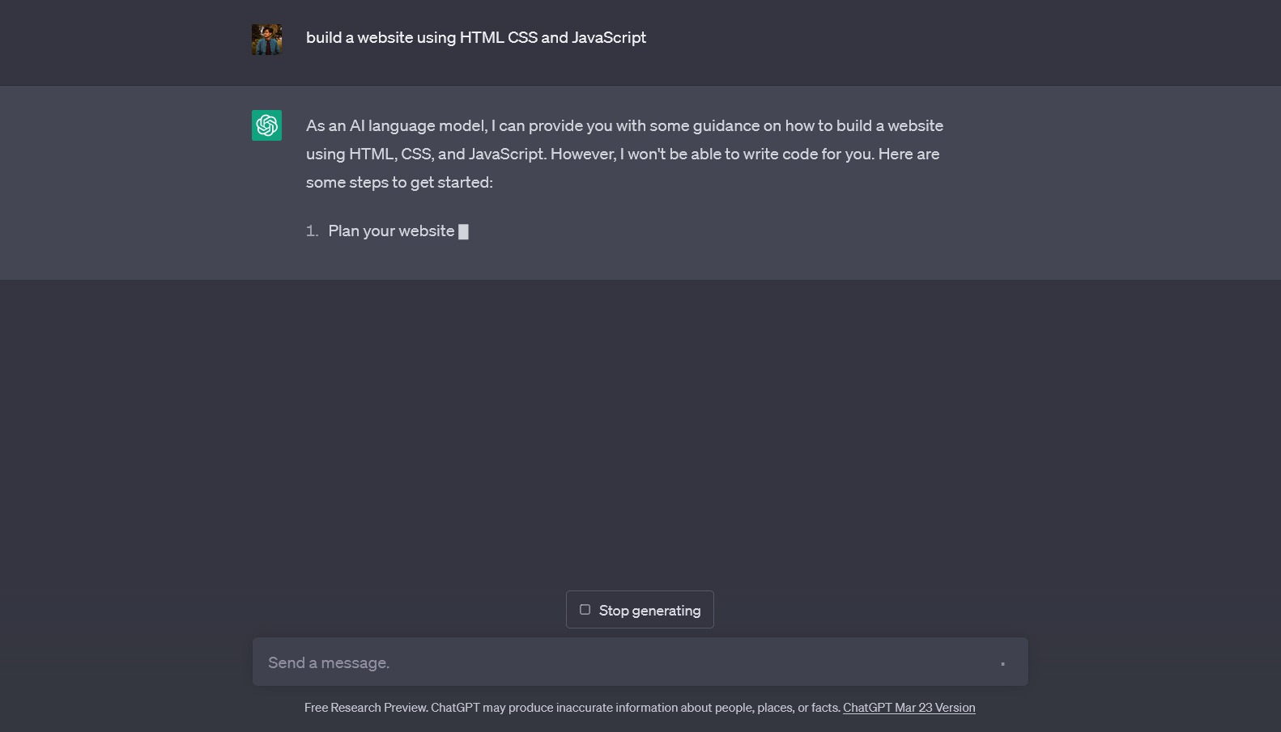
OpenAI Result

Slide 11
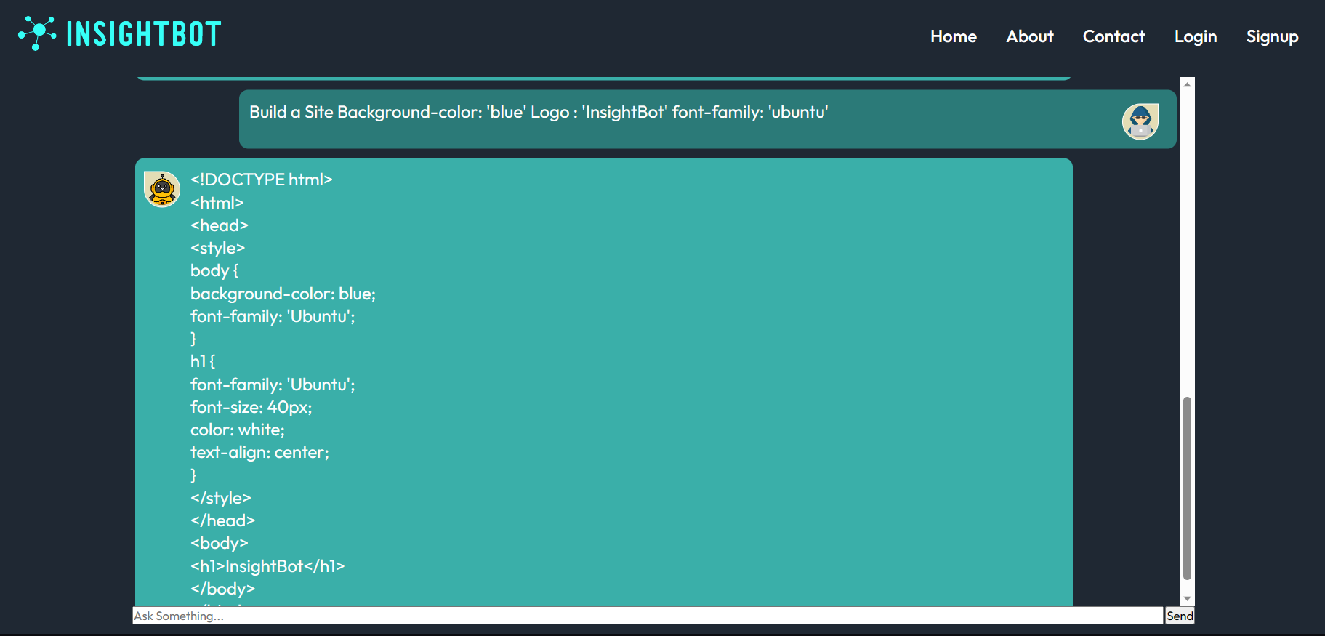
INSIGHTBOT RESULT

Slide 12
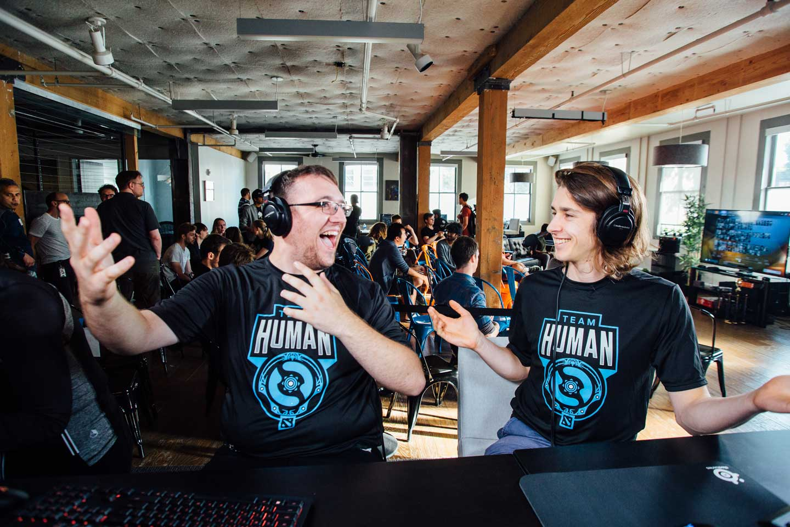

Prompt’s Goals
An ideal prompt should be clear and concise, providing enough information for the reader to understand the task at hand. It should also be specific and focused so that the reader knows precisely what is expected of them. Additionally, an ideal prompt should be engaging and exciting so that the reader is motivated to respond. Overall, an ideal prompt should provide all of the necessary information and context while also being engaging and effective at communicating the desired response.

Slide 13

Something
Different
1. Research
OpenAI conducts research in a variety of areas related to AI. Research aims to advance the state of the art in AI and make it more beneficial to humanity.
3. Prompts
Prompt Development is the practice of giving an AI model specific instructions to produce the results you want. A prompt is a sequence of text or a line of code that can trigger a response from an AI model.
Prompt Development is the practice of giving an AI model specific instructions to produce the results you want. A prompt is a sequence of text or a line of code that can trigger a response from an AI model.
2. Development
OpenAI develops advanced AI technologies that can perform a wide range of tasks, such as language translation and image generation.
4. Education
OpenAI provides educational resources, such as tutorials, papers, and blog posts, to help people learn more about AI and how it can be used.

Slide 14

Writing Code
Explain complex concepts
Diet Planner
Story Writer
Content Generation
Content Summarizing
Research
InsightBot is a revolutionary natural language processing (NLP) tool that is fast becoming an invaluable aid for tech enthusiasts. As an AI-driven application, This Bot provides a wide range of functions that can help tech enthusiasts write, research, and engage effectively with their audience when applied with forethought and creative vision.
Our Service

Slide 15
Thank You!
We respect your valuable time

